Slide 1
Project 1: Sleep Study
Lydia Bartnick
Anna Collawn
Gil Fernandez
Jared Sletto

Slide 2
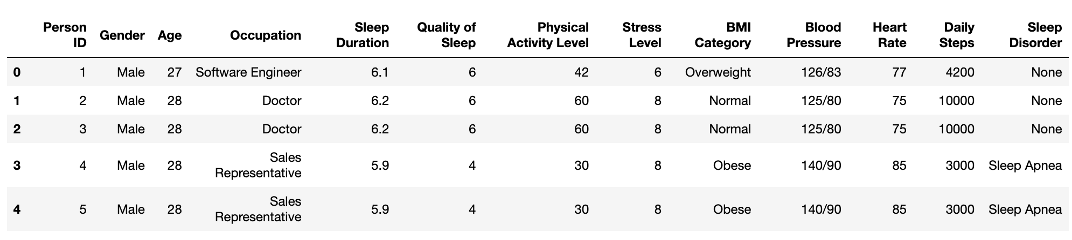
Sleep Data CSV
Notes:
The Sleep Health and Lifestyle Datasetl ooks at a wide range of variables related to sleep and daily habits. It includes details such as gender, age, occupation, sleep duration, quality of sleep, physical activity level, stress levels, BMI category, blood pressure, heart rate, daily steps, and the presence or absence of sleep disorders.
Our group chose to analyze this dataset so we can see how sleep affects or is affected by the factors above.

Slide 3
Overview
Exploring the different relationships within the dataset.
Is there a relationship between sleep duration, quality of sleep, and physical activity with different physiological responses?
Does age, gender, and profession play a role in the duration and quality of sleep?

Slide 4
What impact does age have on stress and sleep?
Why can’t I pull those college all nighters anymore?
Do we get more stressed out when we age due to sleep?

Slide 5
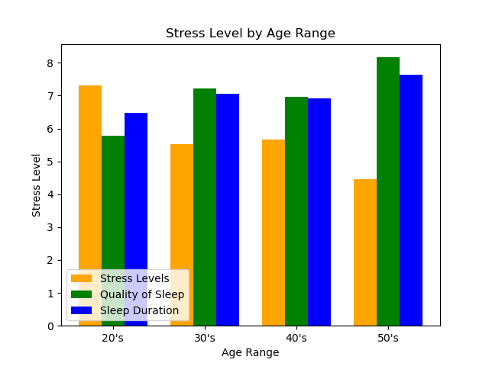
On average, people who slept more were less stressed
Bar graph shows the averages of each category by age group.
Our data csv file included an age column
Created bins and calculated the average per bin
Why does stress increase in 40s and sleep decrease?

Slide 6
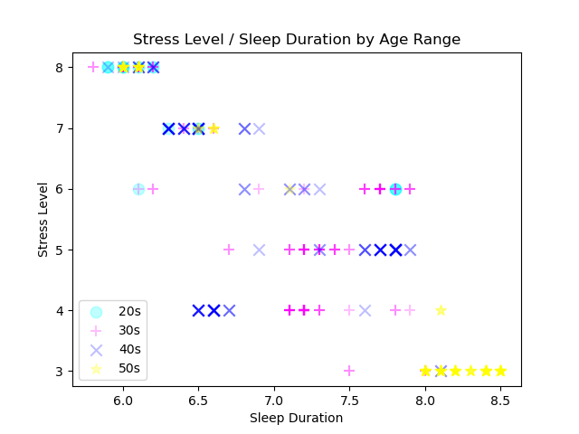
All Participants – Sleep Duration
Negative relationship
~50 points used on this graph
354 participants
Used different shapes and colors to show different age groups
Decreased the alpha so bolder colors are more frequent and can see other symbols
No regression lines / Too busy

Slide 7
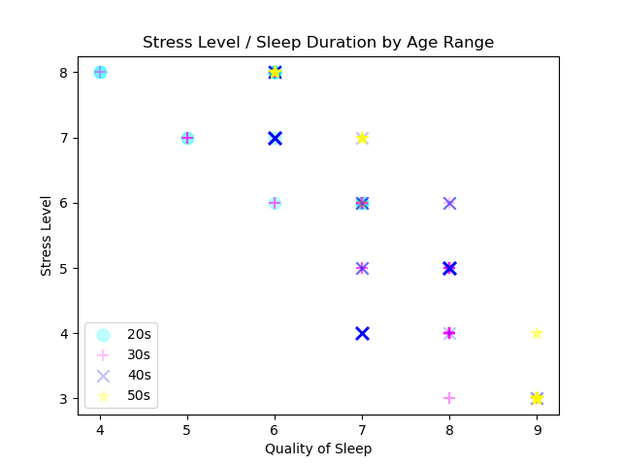
All participants – Quality of Sleep
Only 15 points on this graph
Still 354 participants
No one in their 50s ranked their quality lower than 6.
No one in their 20s ranked their quality higher than 7.
Yet, there are no visible outliers.
Back to Sleep Duration…

Slide 8


Age conclusion
No matter how old you were, if you slept more, you were less stressed.
Chicken or the egg…

Slide 9
Does occupation affect quality of sleep?
Who has it worse… teachers or nurses?

Slide 10
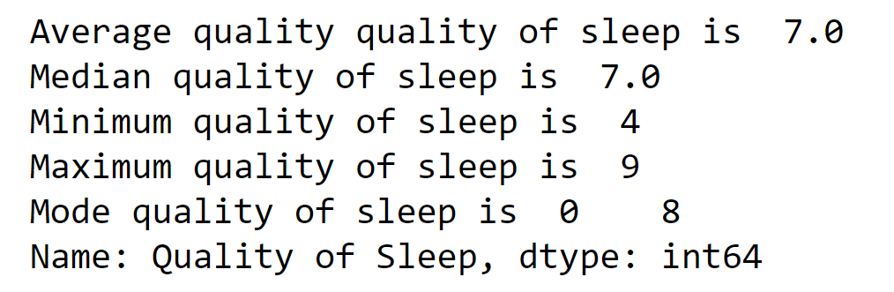
Quality of Sleep
Quality of sleep is the measurement of how well someone sleeps at night.
The average adult needs 7 or more hours of restful and restorative sleep.

Slide 11
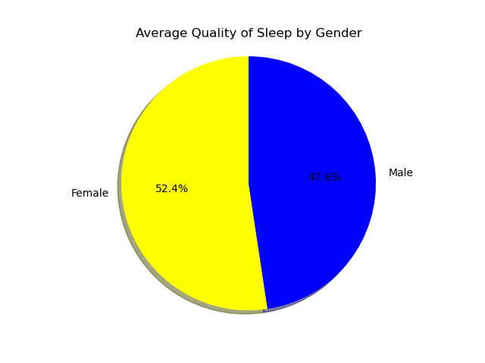
Which Gender Gets the Better Quality of Sleep?
In this dataset, 185 males and 189 females were analyzed.
On average, the females from the dataset get a more restful and restorative sleep.
Females, on average, received 8 hours of quality sleep, while males received 7 hours.

Slide 12
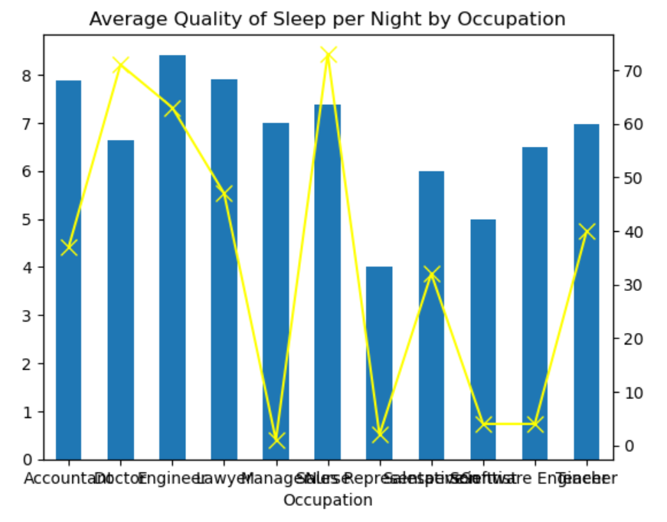
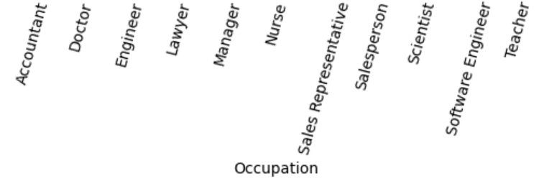
Which Profession Gets Better Quality of Sleep?
Occupation with the best sleep quality is Engineer.
Occupation with the worst sleep quality is Sales Representative.
Eleven professions were analyzed from different industries. This graph represents the average quality of sleep per occupation compared to the total count of each occupation.
Notes:
The left y-axis represents the average quality of sleep per profession, while the right y-axis represents the total count per profession.

Slide 13
Occupation Conclusion
The uneven count of each profession proves to be a limitation to our data. For example, Manager occupation only has only 1 count and an average quality of sleep, where as doctor has a 71 count and a below average quality of sleep.

Slide 14
Which career field has the leanest employees and what's the average BMI for employees?

Slide 15
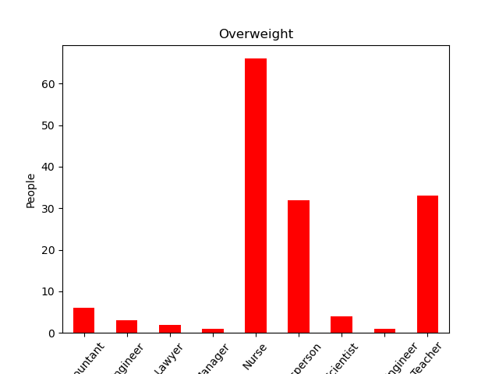
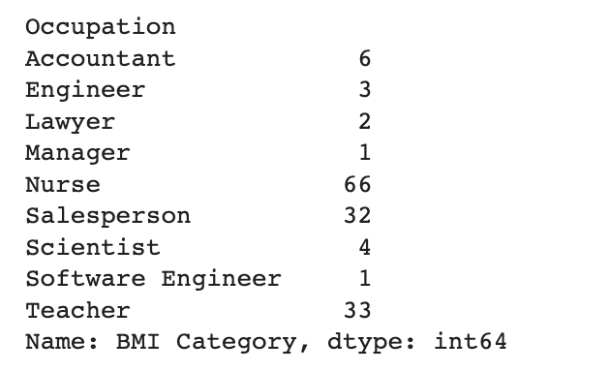
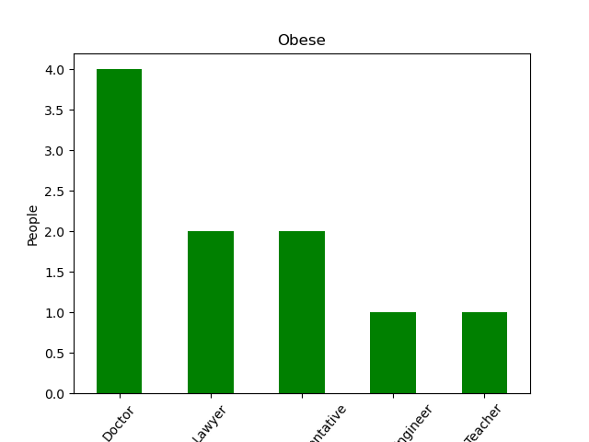
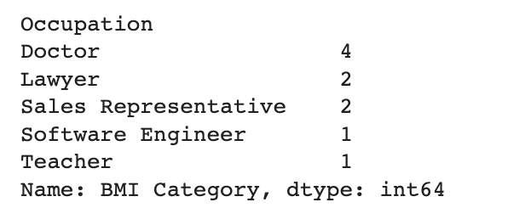
Overweight Count
Obese Count

Slide 16
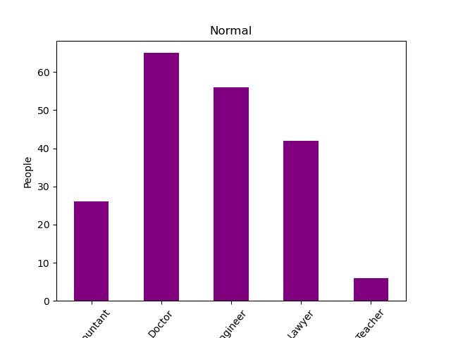
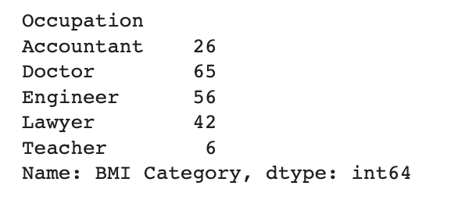
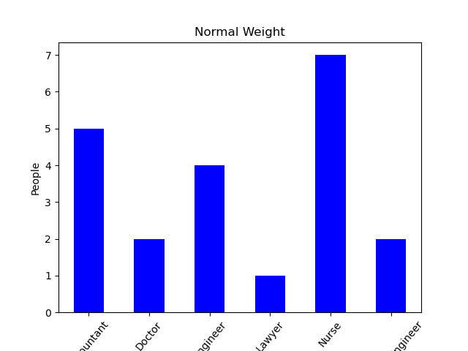
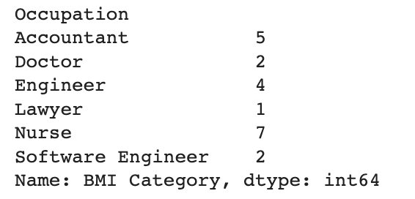
Normal Count
Normal Weight Count

Slide 17
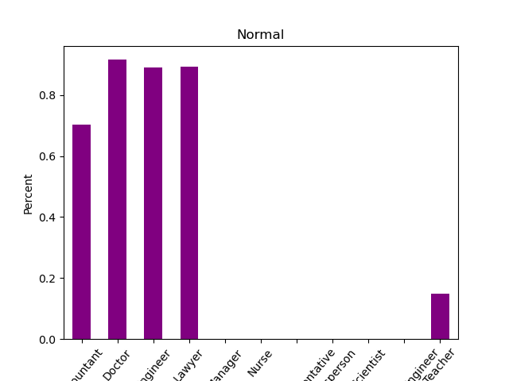
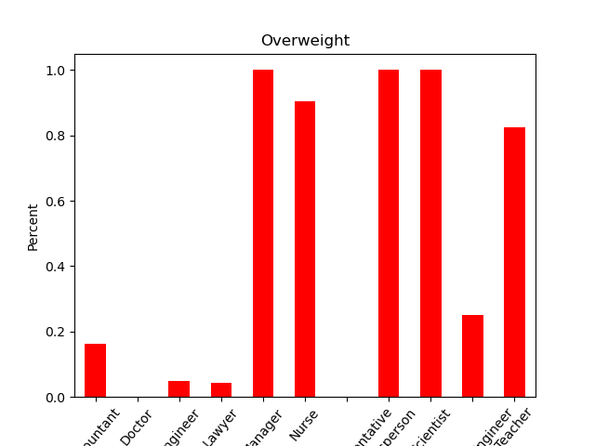
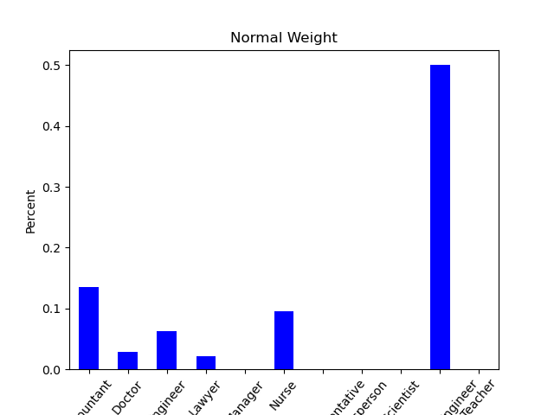
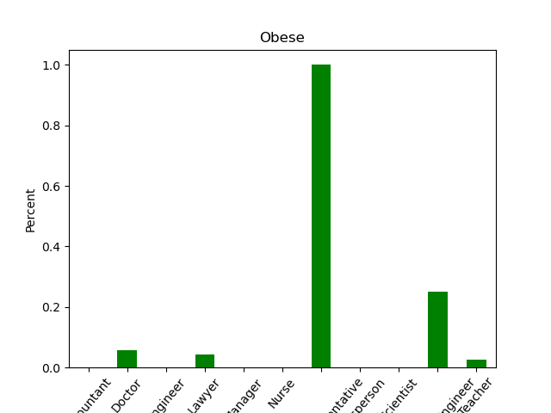
Percentages

Slide 18
BMI and Occupation Conclusion
One major limitation to these findings is the sample size of each occupation.

Slide 19


Is there a relationship between sleep and physical activity levels?

Slide 20
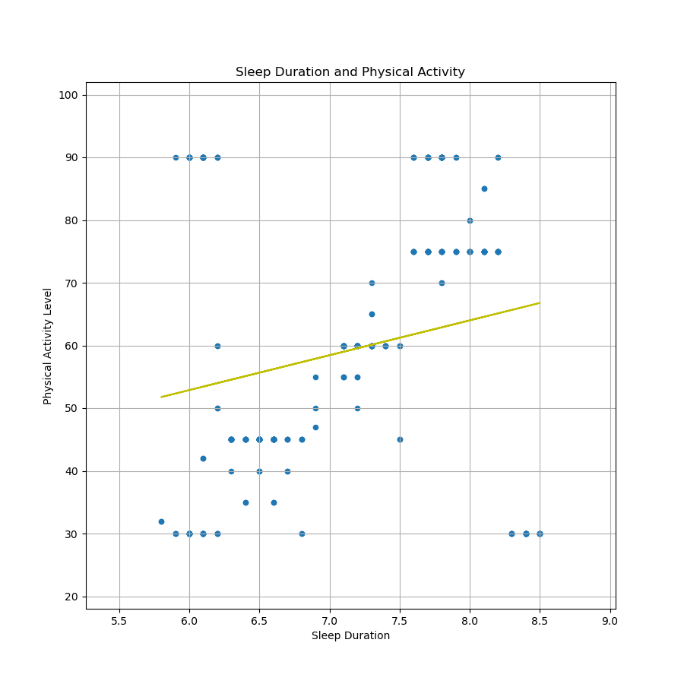
Sleep Duration x Physical Activity Level
Based on this sample, there is a positive correlation between the amount of sleep a person gets and their physical activity levels.
More sleep correlates with more physical activity.
Slope of linear regression = 5.56
Notes:
This is a scatter plot that looks at the relationship between sleep duration and physical activity levels. The x-axis is sleep duration and the y-axis is physical activity levels. The linear regression has a slope of 5.56. This positive slope indicates that there is a correlation between sleep duration and physical activity levels.

Slide 21
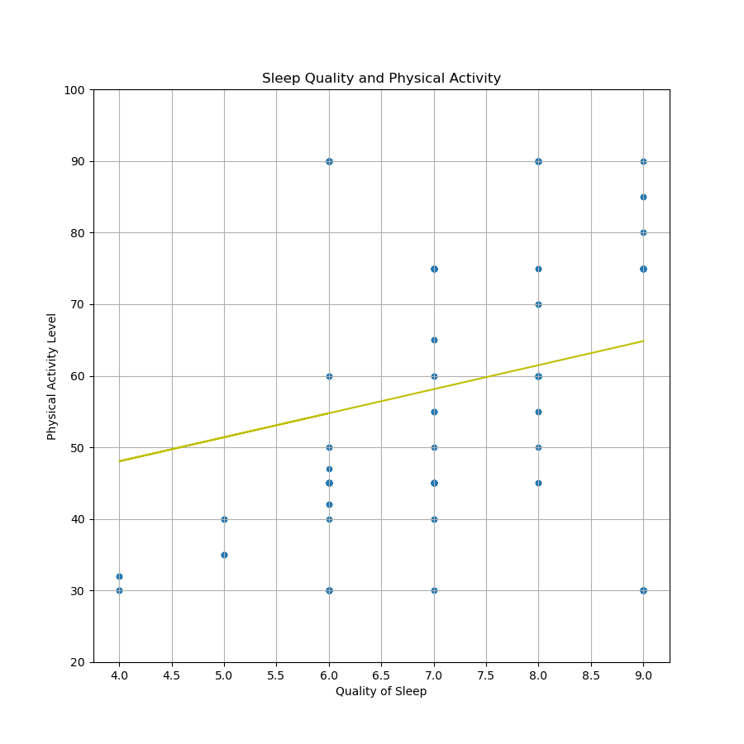
Sleep Quality x Physical Activity Level
While there is a positive correlation between the amount of sleep a person and their physical activity levels, there is a stronger correlation between sleep quality and physical activity levels.
Slope = 3.36
Notes:
This is a scatter plot that looks at the relationship between sleep quality and physical activity levels. The x-axis is sleep quality and the y-axis is physical activity levels. The linear regression has a slope of 3.36. This positive slope indicates that there is a correlation between sleep quality and physical activity levels.

Slide 22
Sleep and Physical Activity Level Conclusion
We see that there is a positive relationship between amount of sleep, quality of sleep, and physical activity levels. This is shown by the slope in the linear regression.

Slide 23
Summary
Sleep is a variable that can influence your lifestyle. While it is not the sole factor, sleep (duration and quality) are influential to a person’s stress levels, occupation, BMI, and physical activity level.

